Slide 1

NAME : janarohith.v

Slide 2
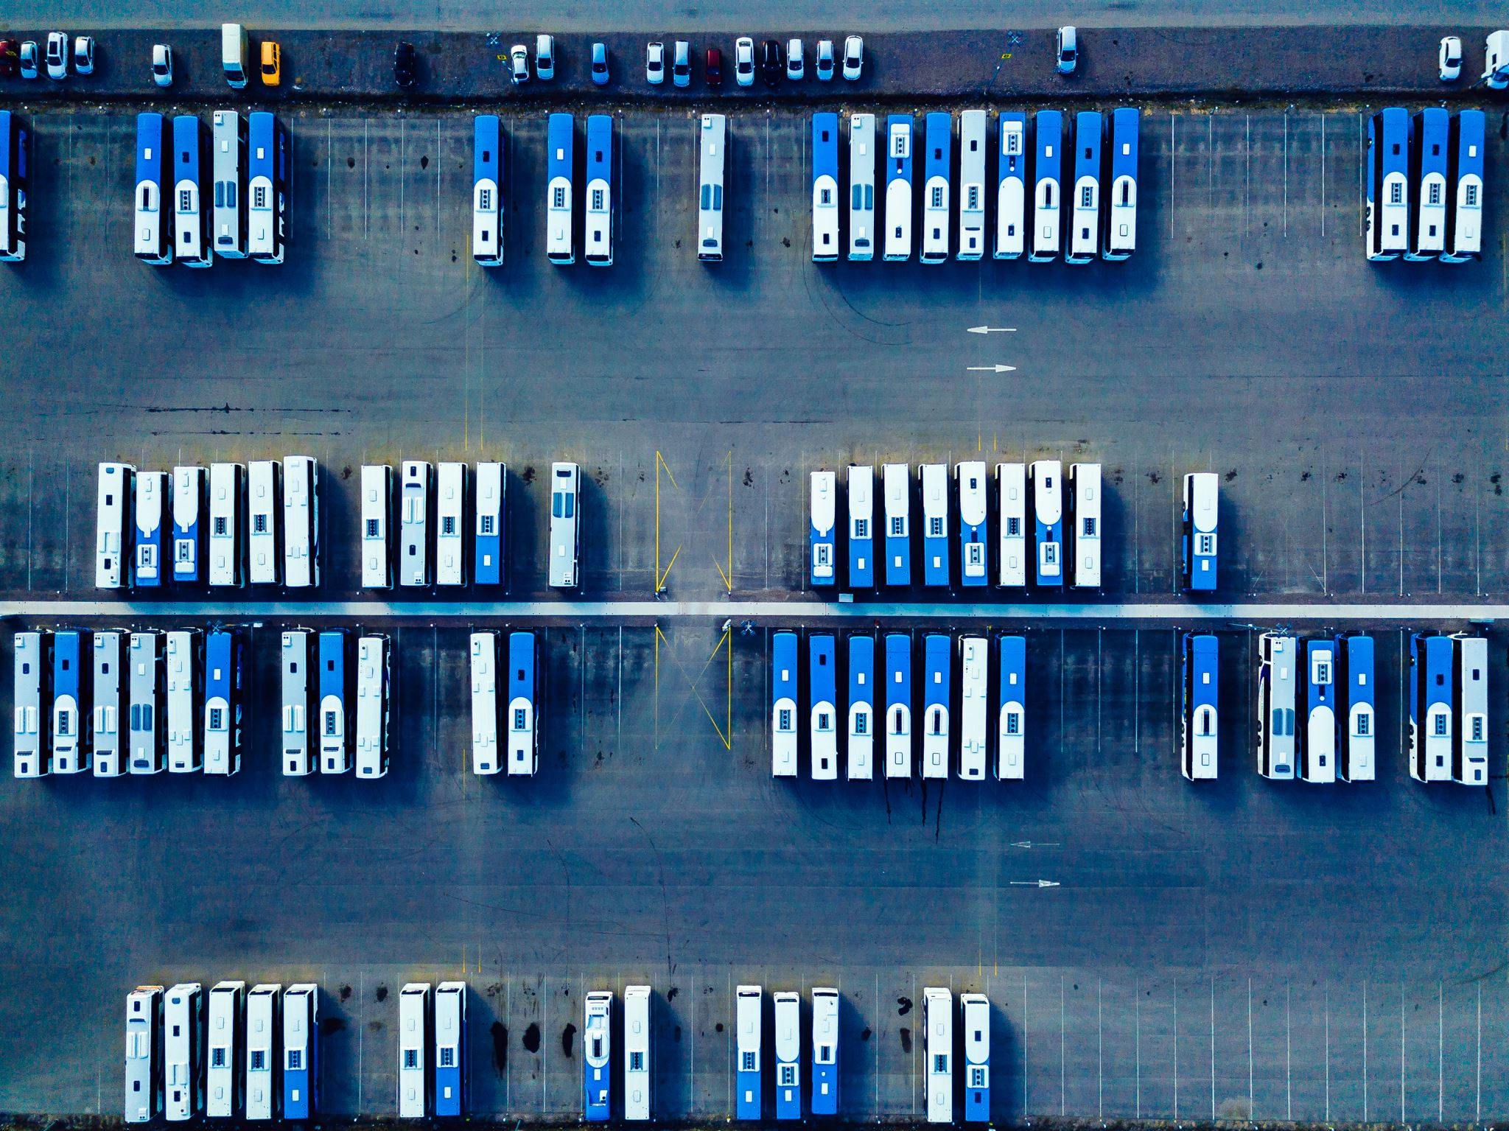
Title: Public Transportation Analysis

Slide 3
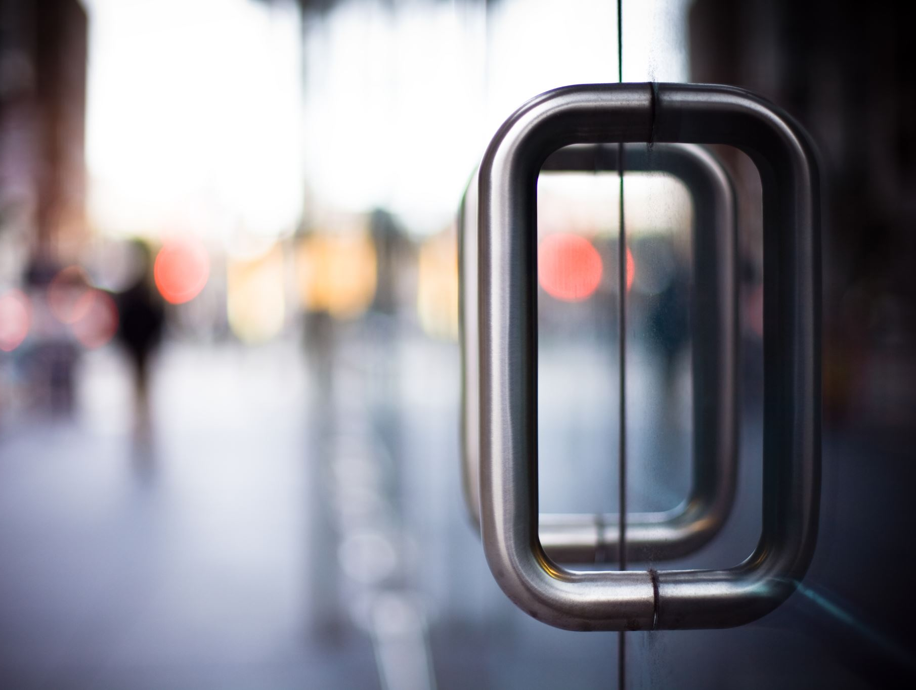
Introduction
- Briefly introduce the topic.- Explain the importance of public transportation in urban areas.- State the objectives of your analysis.

Slide 4
Benefits of Public Transportation
- Highlight the advantages of public transportation, such as reduced traffic congestion, lower emissions, and improved accessibility.

Slide 5
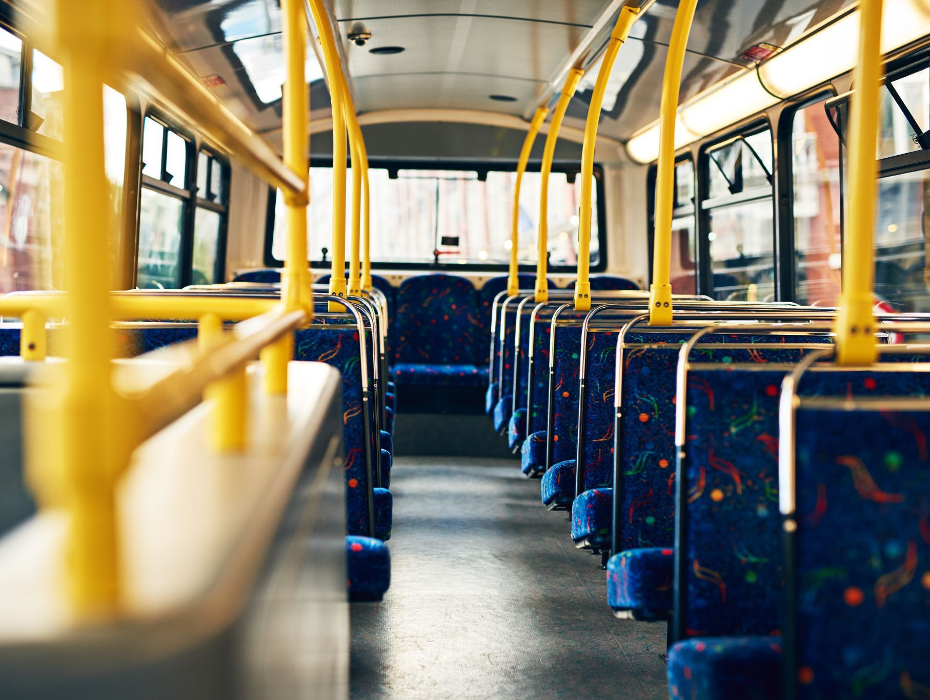
Types of Public Transportation
- Describe different modes of public transportation (e.g., buses, trains, trams, subways, etc.).- Provide examples of each type.

Slide 6
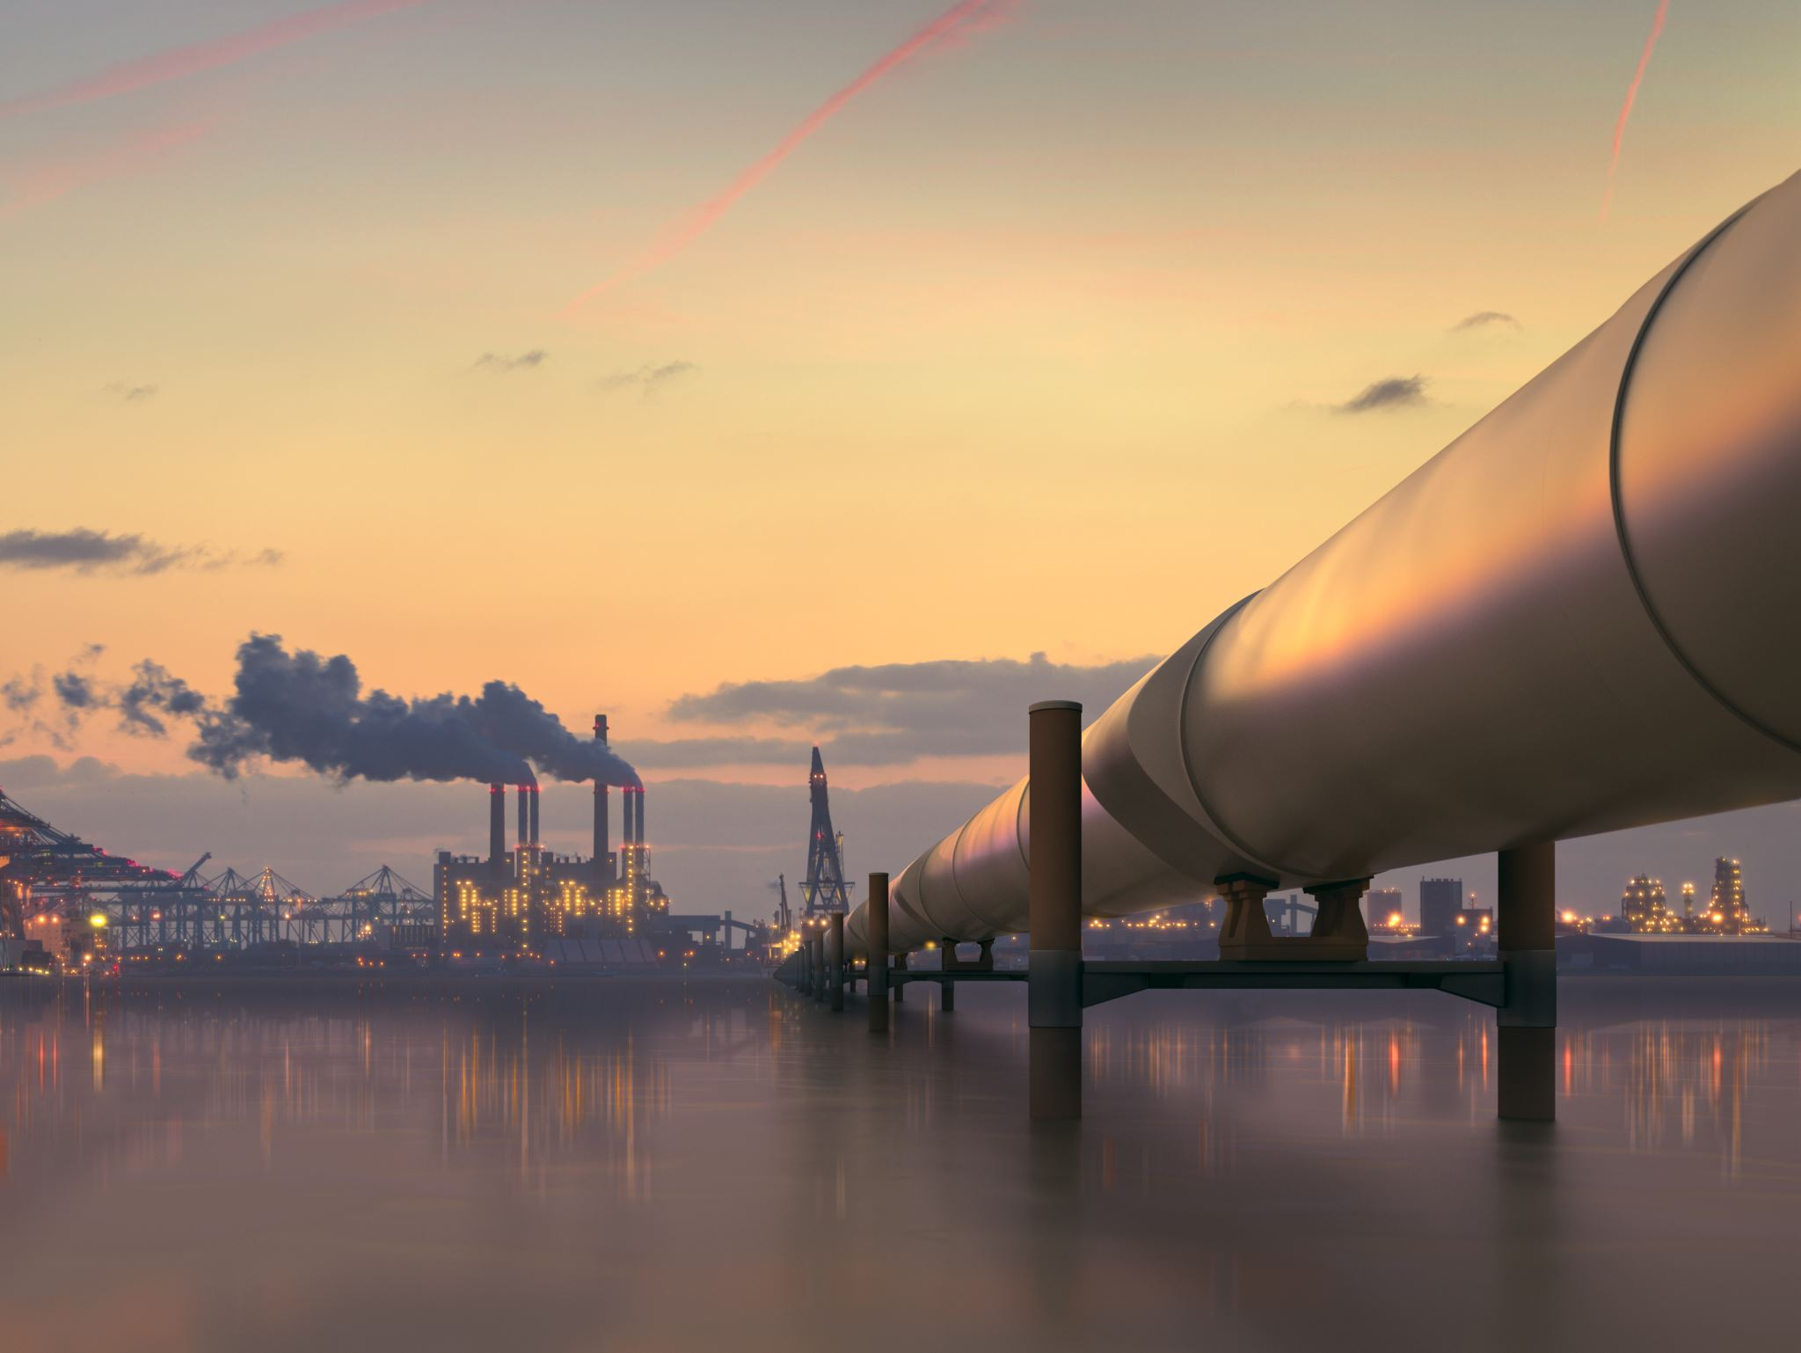
Environmental Impact
- Discuss the environmental benefits of public transportation (e.g., reduced greenhouse gas emissions, air quality improvement).

Slide 7
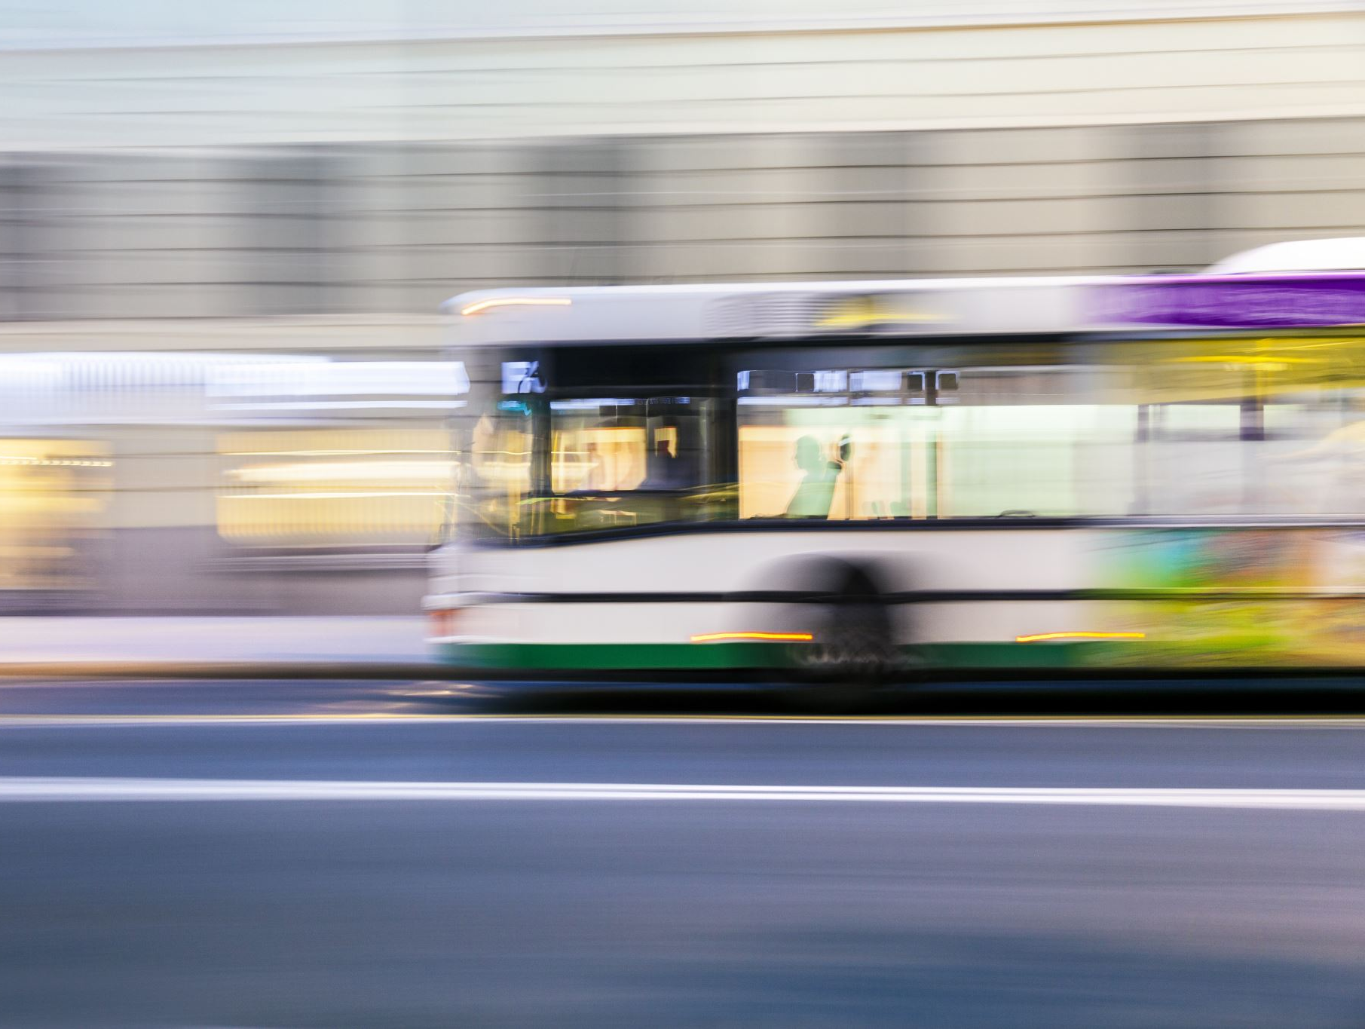
Future Trends and Innovations
- Discuss emerging trends and technologies in public transportation (e.g., electric buses, autonomous vehicles, mobility as a service).
- Mention how these innovations might improve urban mobility.

Slide 8
Public Transportation Challenges in the Future
- Discuss potential challenges that public transportation systems may face in the future (e.g., adapting to new technologies, increasing demand).

Slide 9
Recommendations
- Provide recommendations for improving public transportation in your city or region based on your analysis.

Slide 10
What is the analysis of transportation? Transportation analysis provides the basis for transportation planning. Transportation planning is a process of finding feasible alternatives and components of a transportation system to support human activities in a community.

Slide 11
What is the public transportation? Meaning of public transportation in English a system of vehicles such as buses and trains that operate at regular times on fixed routes and are used by the public: Greater investment in public transportation would keep more cars off the roads. Fewer examples.

Slide 12
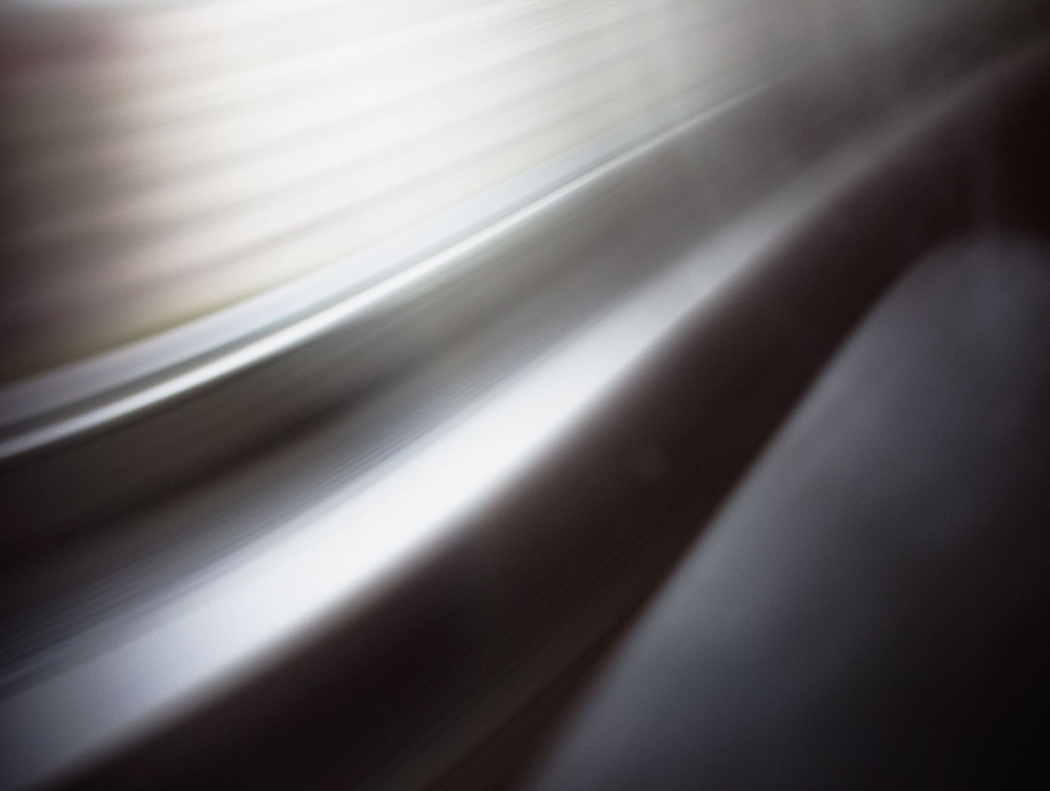
Conclusion
- Summarize the key points of your analysis.- Reiterate the importance of investing in and improving public transportation.

Slide 13
••Thank You ••

